Slide 1
Credit Card Fraud Detection
Leveraging AI-Driven Solution to Detect and Prevent Fraud
Rebecca Cloe, Greg Bauer, Birendra Khimding
Shiley-Marcos School of Engineering, University of San Diego
AAI-510 Machine Learning Fundamentals and Applications
Professor Mirsardar Esmaeili

Slide 2
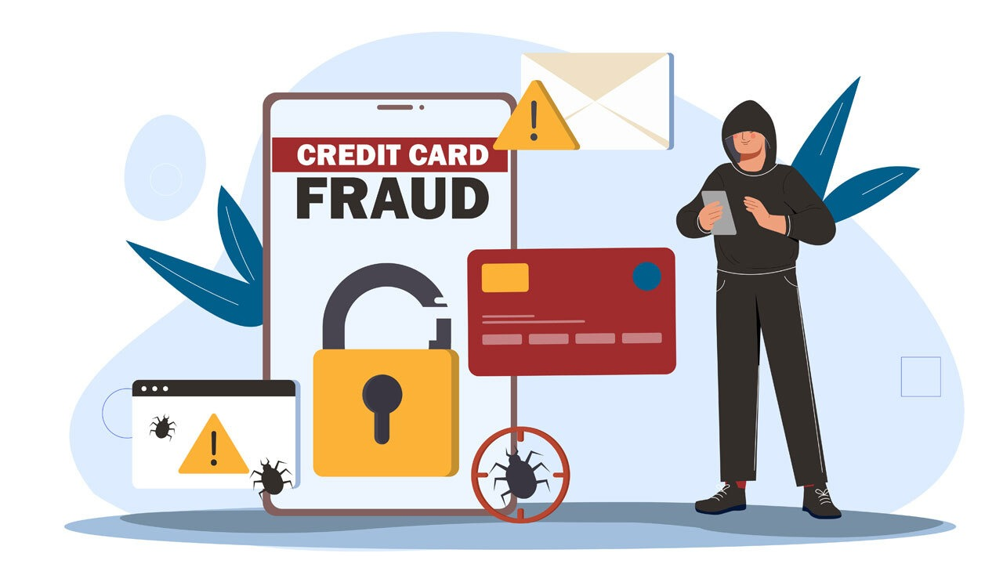
Introduction
Protecting Customer & Profit against Credit Card Fraud
Credit card fraud results in billions of dollars in loss every year globally.
With the increase in online transactions, organizations are more exposed to fraudulent activity
Early detection of fraudulent transactions is important.

Slide 3
Business Problem
Rising Credit Card Fraud Threatens Financial Trust
A single fraudulent transaction can damage customer trust and confidence
Detecting fraud manually is time consuming and expensive
As technology advances, the fraud implementation are getting sophisticated and harder to detect
Detecting fraud early and accurately is crucial for both customers and organizations

Slide 4

Our Goal
Detect Fraud Accurately and in Real Time
Detect fraud accurately and quickly
Reduce false detection
Work on large amount of data in real time

Slide 5
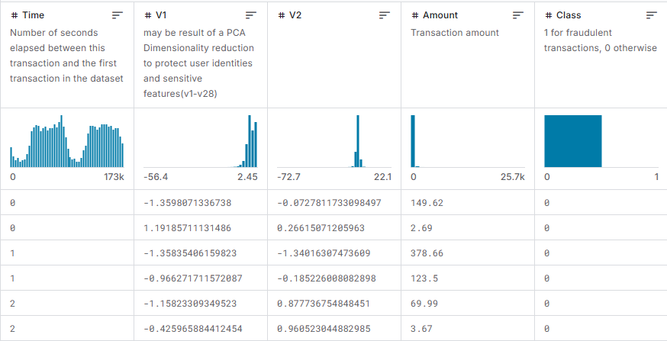
Dataset
The dataset has credit card transactions of two days, with only 0.17% fraud cases
The transactions are transformed for privacy.
Key data are:
  Time
  Transactions
  Amount
  Class (Target)

Slide 6
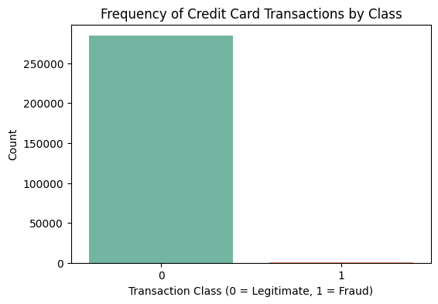
Challenges
High imbalance data:
  Fraudulent data are very less compared to legitimate data.
Transformed features limits for detail feature analysis
Identifying all fraudulent transactions is crucial

Slide 7
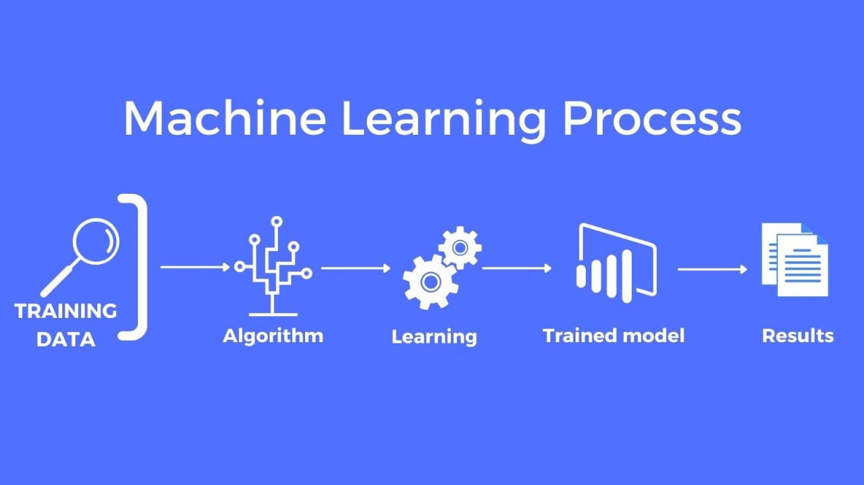
Our Approach
Analysed data to understand patterns.
Addressed data imbalance.
Evaluated different models:
  Logistic Regression
  XGboost
  SVM
Prioritized model that can detect most fraudulent transactions.

Slide 8
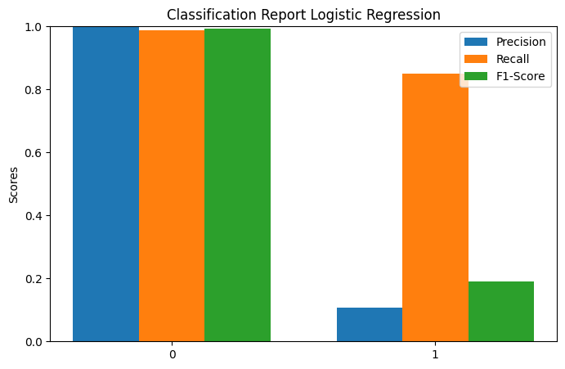
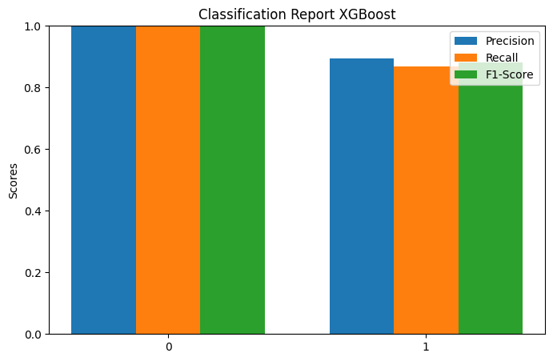
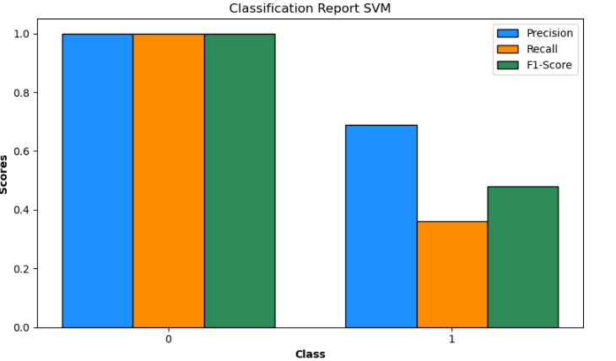
Results

Slide 9
Best Model

Slide 10
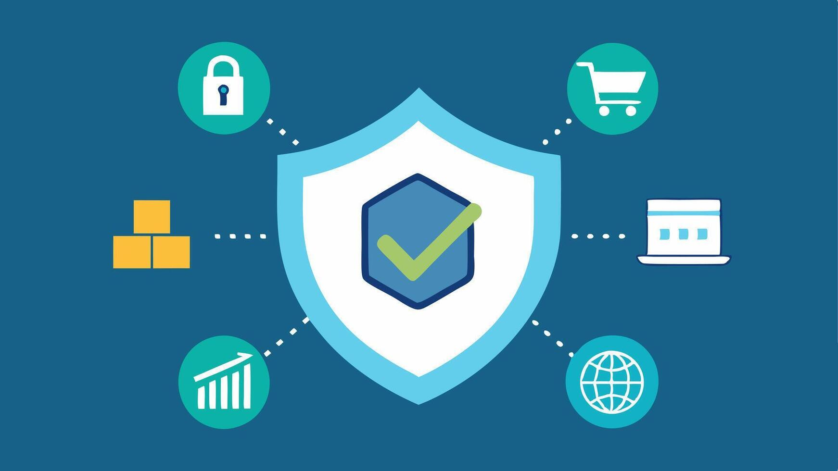
Business Impact
Catching fraudulent transactions early saves money and earns customers trust.
Builds organizational trust and reputation.
Improve customer satisfaction.

Slide 11
Risk and Mitigation
Missing fraud transaction:
  Implement real time monitoring system
Overdependence on the model:
  Combining prediction with a expert team to review.
Bias:
  Regular check for biases in the model
Model become outdated:
  Updates and timely retraining of the model

